Slide 1
Applied Data Science with R Capstone project
Linh Nguyen
<July 10th 2024>

Slide 2

Outline
Executive Summary
Introduction
Methodology
Results
Conclusion
Appendix

Slide 3

Executive Summary
Use data of weather and rental bike of cities to predict the rental bike counts in the next 3 hour
Data analysis of Seoul bike sharing dataset
Build predictive model based on weather attributes and past rental bike count

Slide 4

Introduction
Goal: analyze how weather would affect bike-sharing demand in urban areas
Tech stack: R, SQL and Shiny
Task: Predict the number of bike in demand using various weather factor
Target: Bike Count
Predictors: Date, Past Rented Bike Count, Hour , Seasons, Holiday, Humidity, Windspeed, Rainfall, Snowfall

Slide 5

Methodology
Perform data collection
Perform data wrangling
Perform exploratory data analysis (EDA) using SQL and visualization
Perform predictive analysis using regression models
How to build the baseline model
How to improve the baseline model
Build a R Shiny dashboard app

Slide 6
Methodology

Slide 7
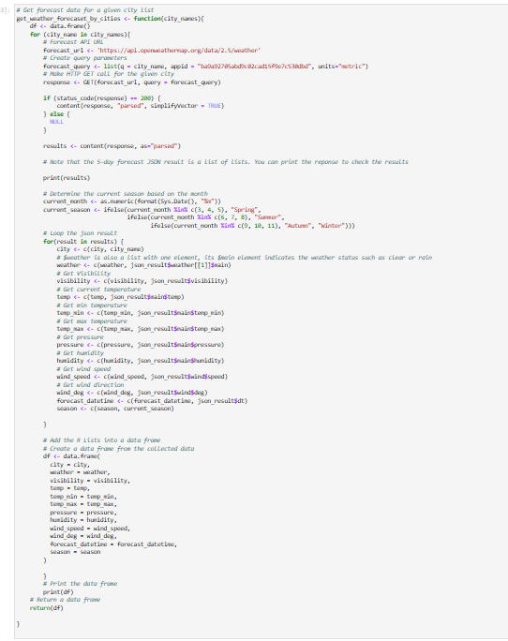
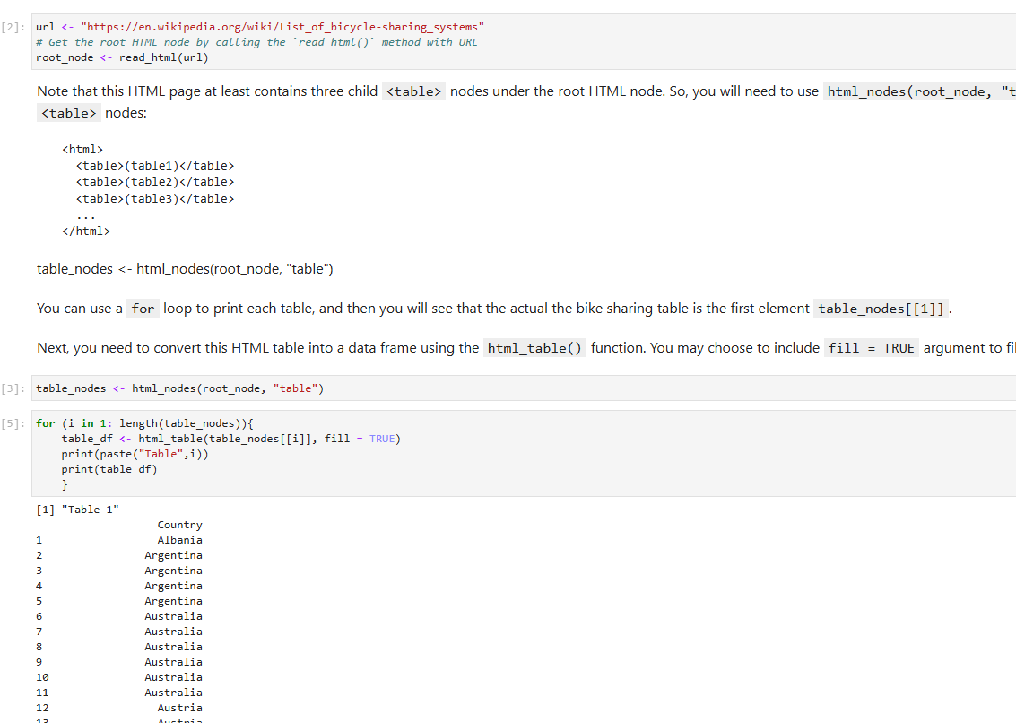
Data collection
Convert data from .csv to dataframe
Web scrap
Open Weather API call

Slide 8
Data wrangling
Standardize columns names
Data Formatting
Detect and Handle missing values
Normalizing data

Slide 9
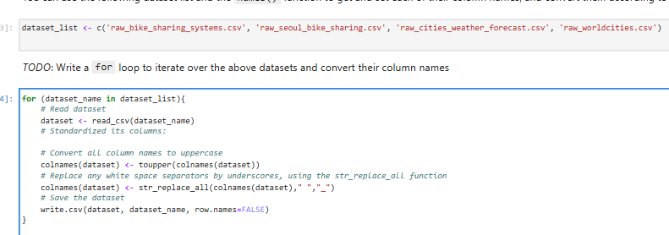
Standardize the columns
Uppercase all letter and separation using underscore

Slide 10
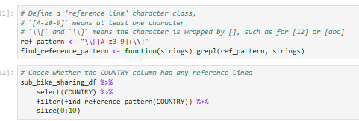
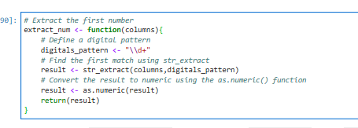
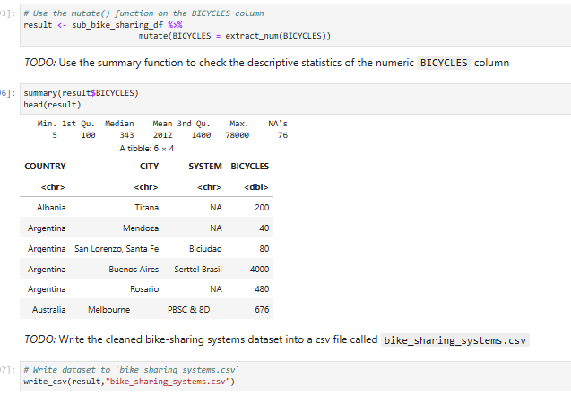
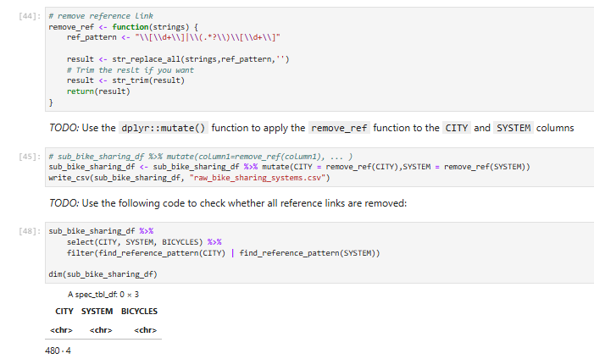
Data Formating
Attributes: CITY, SYSTEMS: remove numeric value
Attribute: BICYCLES: extract the first digital number
10

Slide 11
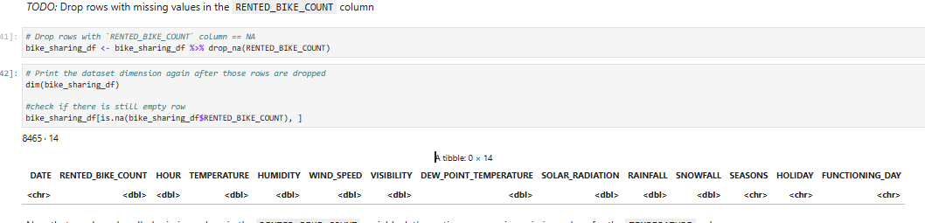
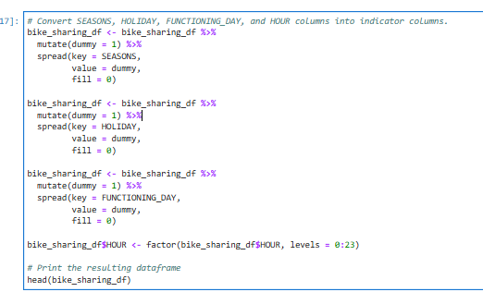
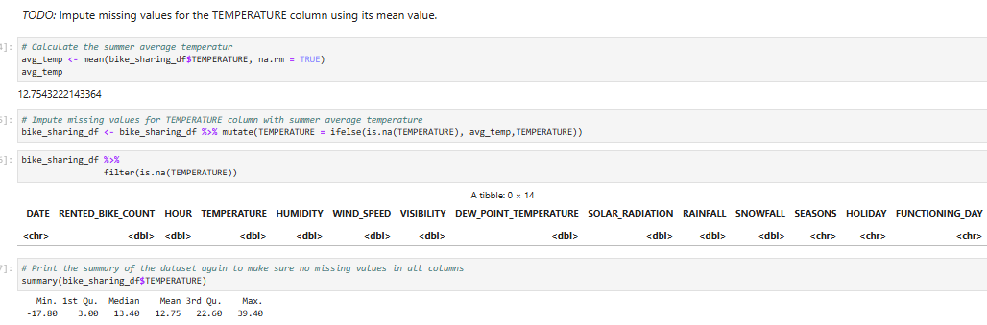
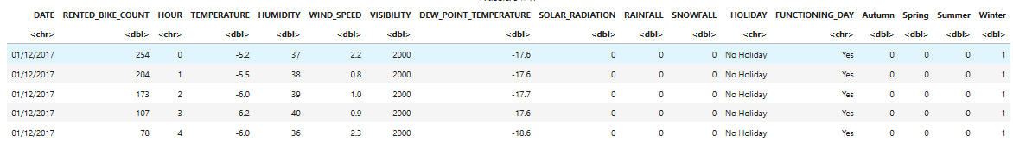
Detect and Handle missing values
Attribute RENTED_BIKE_COUNT : Drop missing values
Attribute SEASONS, HOLIDAY, FUNCTIONING_DAY: convert to indicator variable
Attribute HOUR: convert to numeric value in range of 0 to 23
Attribute TEMPERATURE: replace missing values with mean

Slide 12
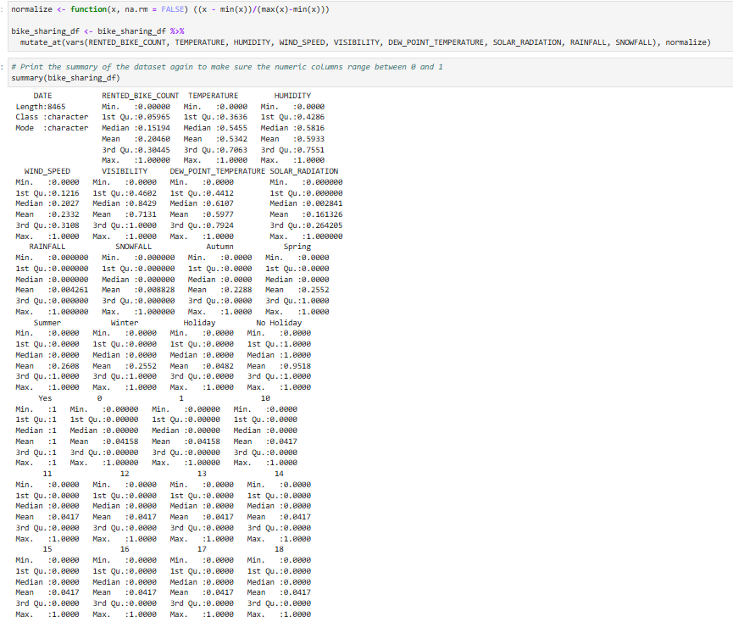
Normalizing data: use max-min normalization

Slide 13
EDA with SQL
Aggregate function: min, max, mean, sd, count, select, rename
Add screenshots of all required SQL queries to the Appendix section

Slide 14
EDA with data visualization
Charts plotted: Scatter chart, bar chart, line chart, column and line chart
Library: ggplot2

Slide 15
Predictive analysis
Build Model
simple linear regression and multi-linear regression
polynomial regression
Regulation: Lasso, Ridge, Elastic
Model Evaluation: RMSE and R-squared
Select the best model
Best model error visual: Q-Q plot

Slide 16
Build a R Shiny dashboard
Plots
Temperature prediction of the next 3 hours
Bike prediction of the next 3 hours
Humidity prediction and Bike count relationship
Interactive component
See information when hover to the city
Click on plot to see time and number of bike count

Slide 17
Results
Exploratory data analysis results: TEMPERATURE and RAINFALL highly correlated with the BIKE_RENTAL_COUNTs
Predictive analysis results: multi-linear regression model perform best
A dashboard demo in screenshots

Slide 18
EDA with SQL

Slide 19
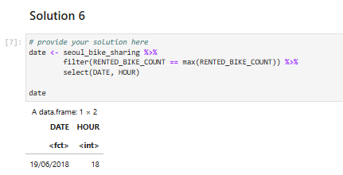
Busiest bike rental times
Get the DATE and HOUR equal to the max RENTED_BIKE_COUNT

Slide 20
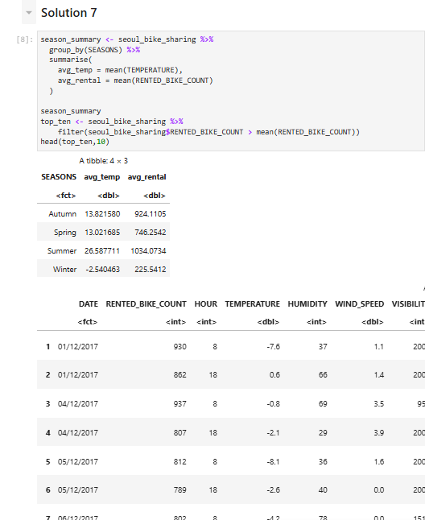
Hourly popularity and temperature by seasons
Group the data by SEASONS
Compute the mean TEMPERATURE and mean RENTED_BIKE_COUNT

Slide 21
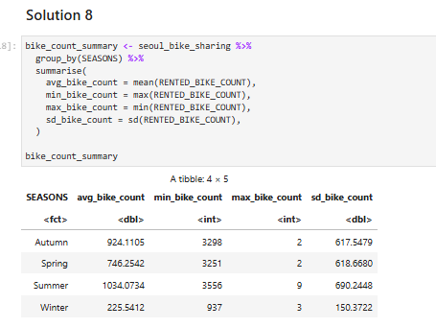
Rental Seasonality
Group data by seasons
Compute mean, max, min, standard deviation of each season

Slide 22
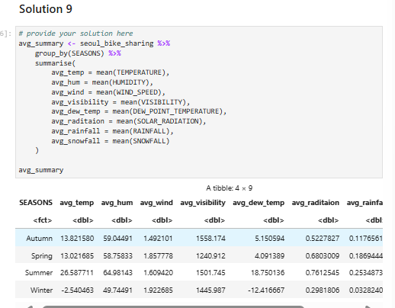
Weather Seasonality
Group data by seasons
Compute the mean of all predictor attributes
Predictor attributes: TEMPERATURE, HUMIDITY, WIND_SPEED, VISIBILITY, DEW_POINT TEMPERATURE, SOLAR_RADIATION, RAINFALL, SNOWFALL

Slide 23
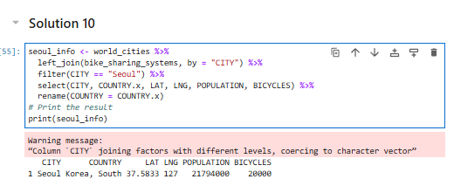
Bike-sharing info in Seoul
Left Join world_cities with bike_sharing_systems
Filter out city that is Seoul

Slide 24
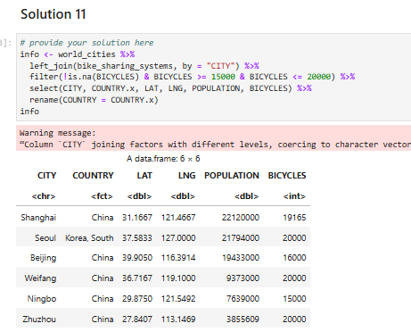
Cities similar to Seoul
Left Join world_cities with bike_sharing_systems
Filter cities with BICYCLES between 15000 and 20000

Slide 25
EDA with Visualization

Slide 26
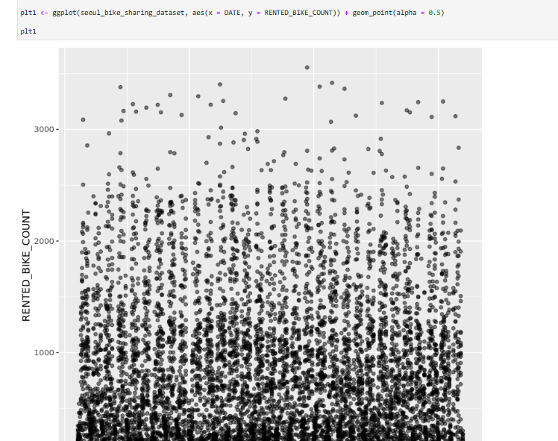
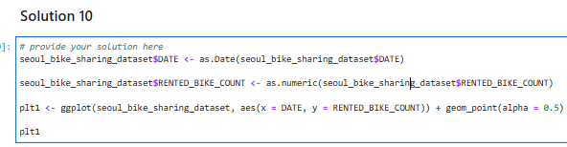
Bike rental vs. Date

Slide 27
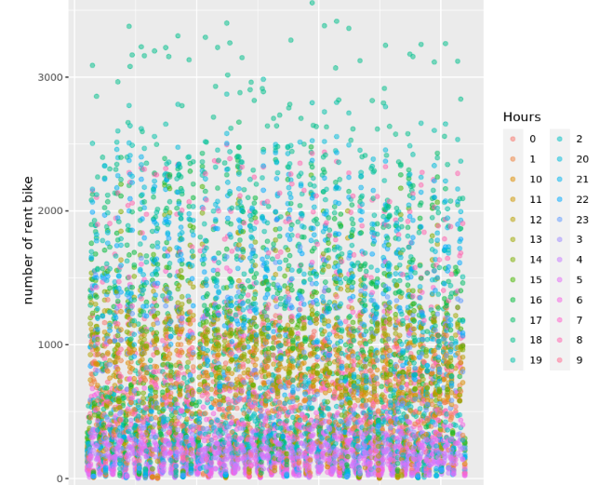
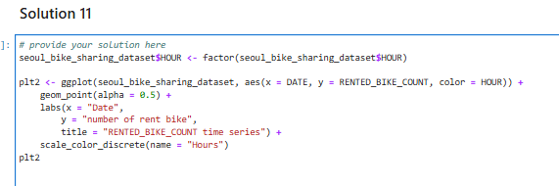
Bike rental vs. Datetime
X- values: Date
Y- values: number of rented bike
Color: Hours
27

Slide 28
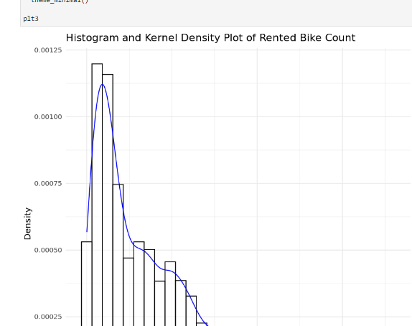
Bike rental histogram

Slide 29
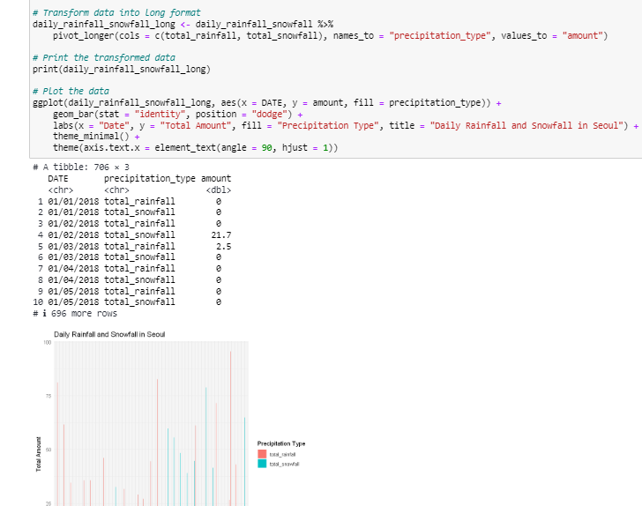
Daily total rainfall and snowfall

Slide 30
Predictive analysis

Slide 31
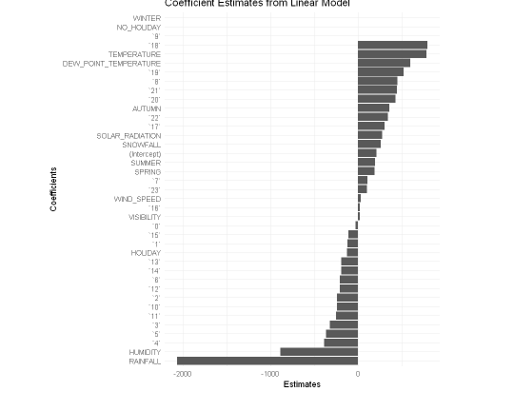
Ranked coefficients
Target variables: RENTED_BIKE_COUNT
High positive correlative variables: TEMPERATURE, DEW_POINT_TEMPERATURE
High negative correlative variables: RAINFALL, HUMIDITY
Customers tend to prefer biking with warm temperature with no rain and dry weather

Slide 32
Build Model
reg_lasso: use lasso regulation, grid search for the best penalty
reg_ridge: use ridge regulation, grid search for the best penalty
reg_elastic: use elastic regulation, grid search for the best penalty
poly: Polynomial model: temperature^2,rainfall^2,snowfall^2
multi_lm1: Multi-linear regression: Temperature, rainfall, snowfall
multi_lm2: Multi-linear regression: Temperature, rainfall, snowfall, wind speed

Slide 33
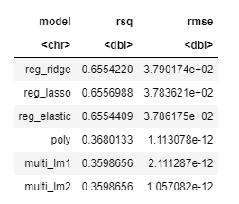
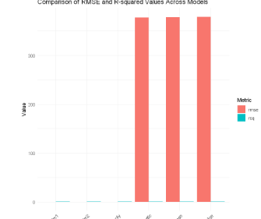
Model evaluation

Slide 34
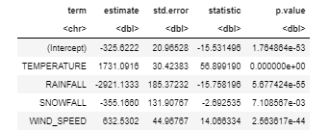
Find the best performing model
Best perform model: multi_lm2
Formula
RENTED_BIKE_COUNT ~ TEMPERATURE+RAINFALL+SNOWFALL+WIND_SPEED
Coefficients of multi_lm2

Slide 35
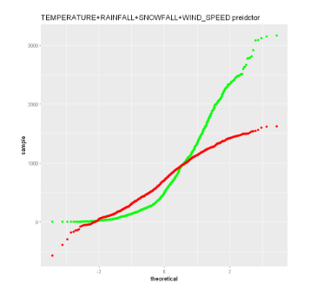
Q-Q plot of the best model

Slide 36
Dashboard

Slide 37
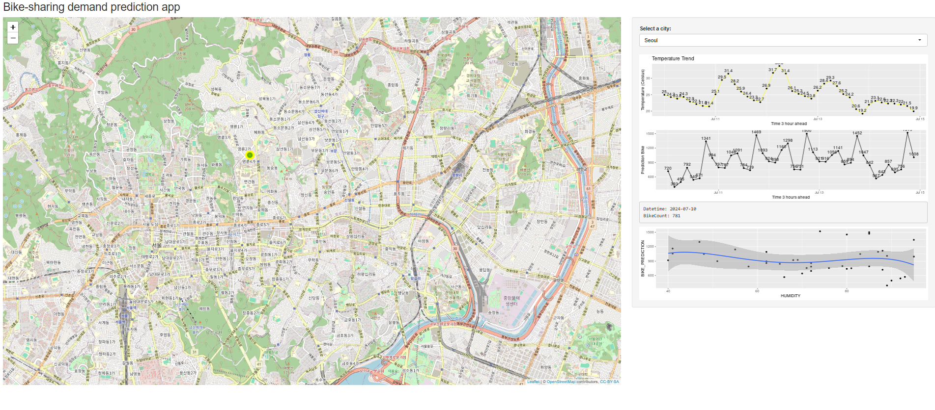
<Dashboard screenshot 1>

Slide 38
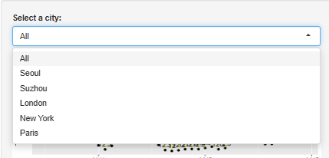
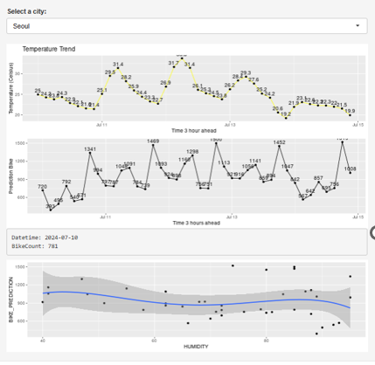
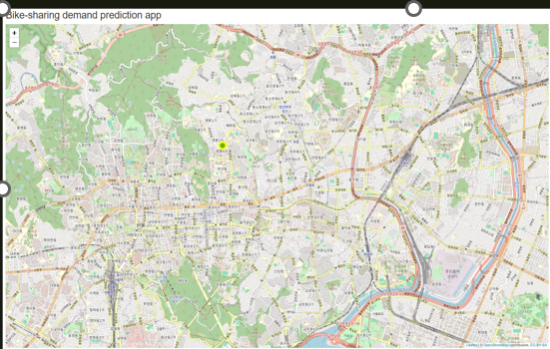
<Dashboard screenshot of Seoul>
Dropdown menu
Graphs
Map

Slide 39
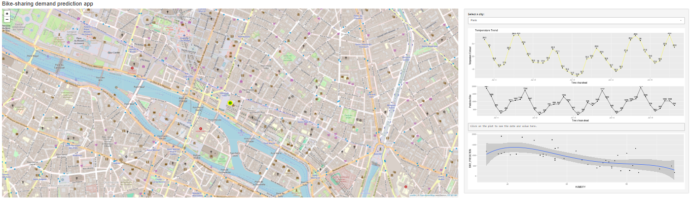
<Dashboard screenshot of Paris>
Replace <Dashboard screenshot 3> title with an appropriate title
Show the screenshot when another specific city is selected
Explain the important elements on the screenshot

Slide 40

CONCLUSION
For method of predictive analysis, multi-linear regression has the least errors
Attributes highly correlated with the targets: Rainfall, Humidity, Temperature

Slide 41
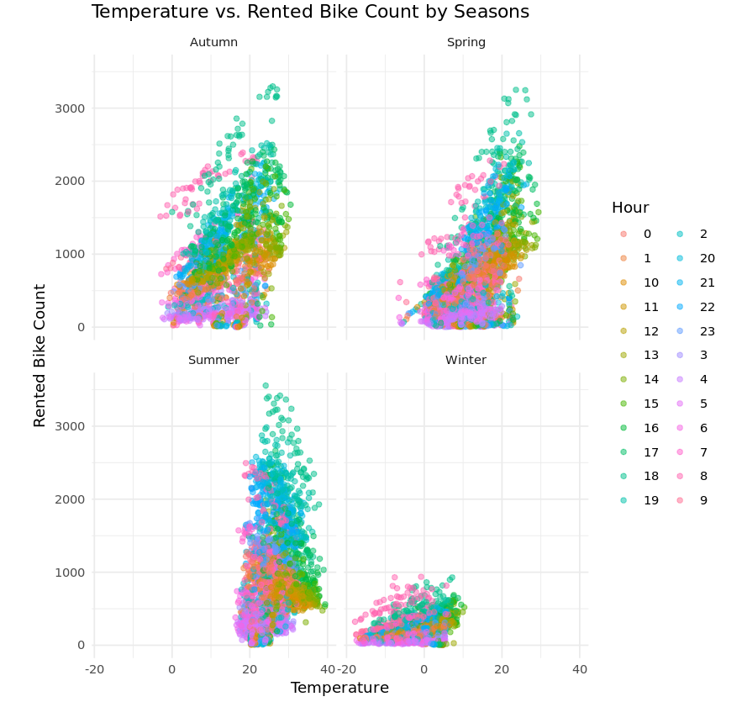
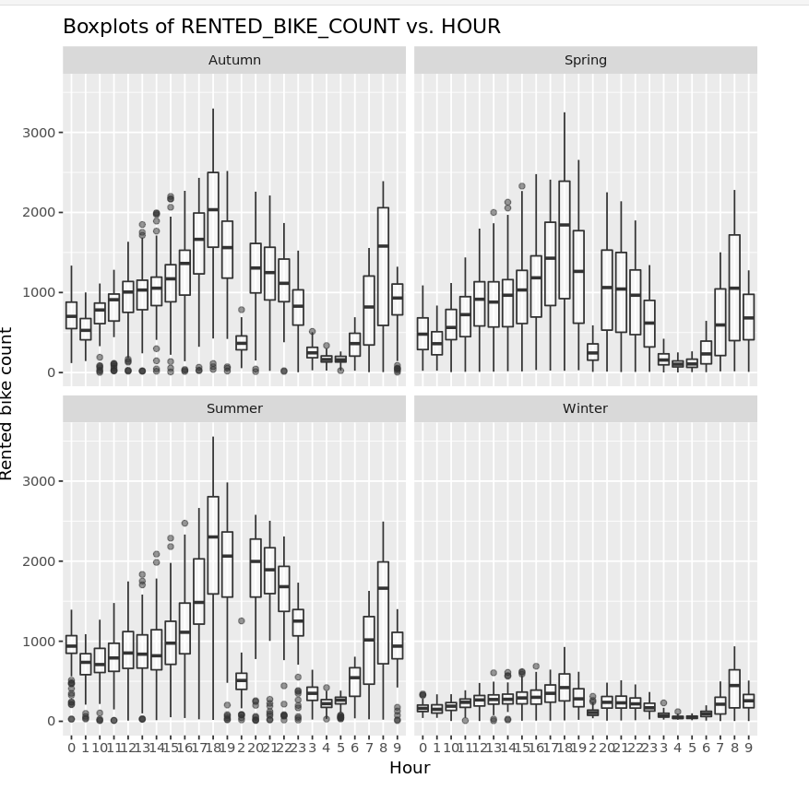

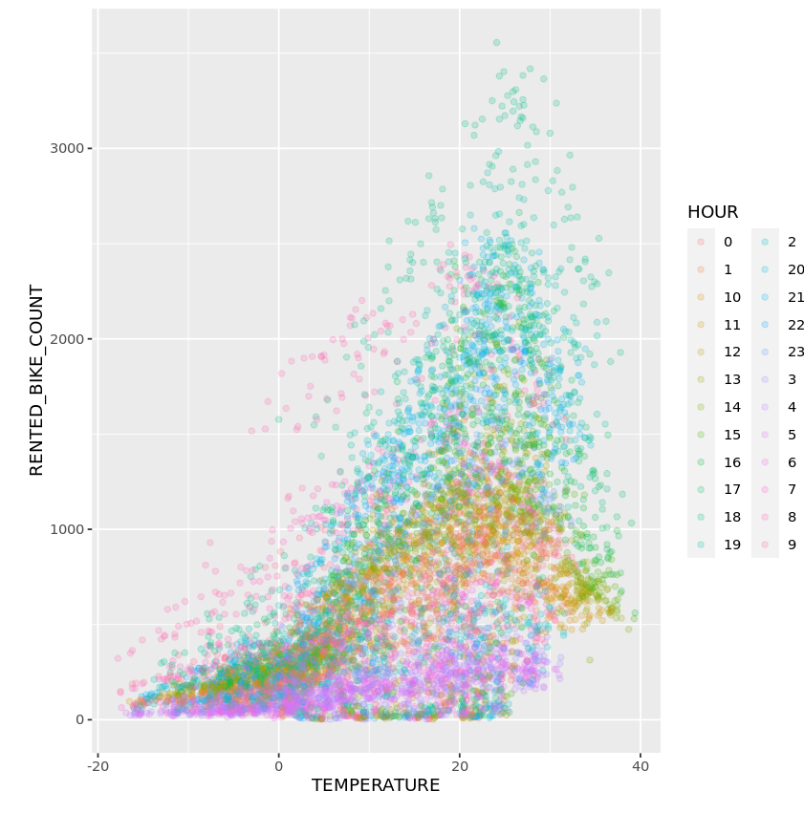
APPENDIX

